Slide 1
Narrative Skills in School-Age Children
Presenter: Aurora U. Quipit, TSHH, M.S., CCC-SLP

Slide 2
Learning Outcomes:
Participants will be able to describe the various
stages, types, and importance of narrative skills
Participants will learn strategies that can develop
and/or enhance narrative skills in school-age
children
Participants will learn assessment tools to evaluate
narrative skills

Slide 3
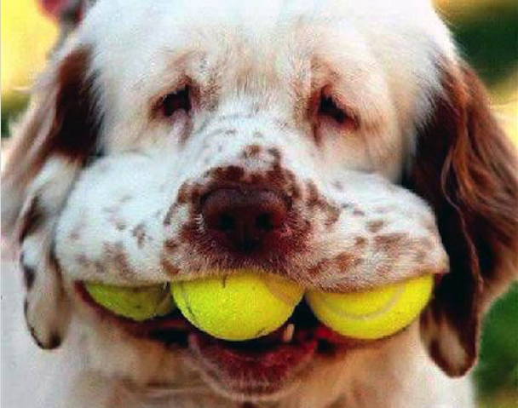
I can do this!!!

Slide 4
We dream, remember, anticipate, hope,
despair, love, hate, believe, doubt, plan,
construct, gossip, and learn in narrative.
-Carol Westby (1991)

Slide 5
What is a Narrative
A narrative is a story composed of many elements such as the setting, characters, problems, attempt(s) to solve the problems,
complication(s)while trying to find a solution(s) to the problems, solutions, and moral lessons if any.
A narrative entails the telling or re-telling of events and experiences in oral or written form. A story can be true or fictitious and takes into account one or more points of view.

Slide 6
What are Narrative Skills
consist of one’s ability to communicate (to tell or retell) a story or a narrative competently and effectively.
involve the building blocks of language, namely:
reading
writing
listening
speaking
gesturing
viewing

Slide 7
Why Narratives Are Important
Narrative as a Social Skill
As social beings, we relate to our social
environment through real and vicarious
experiences.
Sharing of personal information helps us to
make and sustain friendships.
We create our personal identity through the
construction of a personal narrative.
Davies, 2004

Slide 8
Narrative as a Survival Skill
Our thoughts are our private narratives which:
help us link cause and effect
help us plan ahead
allow our behavior to be governed by rules
separate affect from action
Students with poor narrative skills:
have difficulty sharing their experiences
with others
have difficulty making and keeping friends

Slide 9
deal with social situations in aggressive, non-verbal ways (Hedberg, 1986)
tend to be more aggressive and to use direct action to solve interpersonal problems (Gallagher, 1999)
have poor oral narrative skills (Powell, 2005)

Slide 10
Narrative as an Educational Skill
The ability to compose a coherent narrative occurs before and predicts successful access to literacy at school (Naremore, 1995)
Poor oral narrative skills in pre-school is a predictor of difficulty with early literacy skills (Boudreau et al., 1999)
Oral narrative skills in the early years predicts academic progress (Bishop and Edmundson, 1987)
Narrative skills are important for learning language and social skills
A student’s narrative skills predict their reading comprehension skills. Reading comprehension skills are measured by one’s ability to retell the story read.
Development of narrative skills is a significant step towards writing expository text.

Slide 11
Types of Narratives ( Hedberg and Westby, 1993)
Scripts: This form of narrative is used to express knowledge of a familiar, recurring event; usually told using the second person pronoun you and the present tense.
Recounts: This type of narrative involves telling about a personal experience when prompted; most often uses the
past tense.
Accounts: In this form of narrative, the person explains a personal experience without a prompt; the experience is usually not shared by the listener.

Slide 12
Event Casts: This is about explaining an ongoing activity, reporting on a factual scene, or telling about a future plan.
Fictional Stories: This narrative involves relating past, present, or future events that are not real. The events being described in the story focus on someone or something attempting to carry out a goal.

Slide 13
Stages of Narrative Development
(Applebee, 1978)
Stage 1: Heaps (2years)
consist of labels and descriptions of events
and actions
no central theme or organization
no real high point
Stage 2: Sequences (2-3 years)
consist of labeling events about a central theme,
character, or setting

Slide 14
Stage 2 (con’t)
no plot
events could be listed in any order without
changing the meaning
Stage 3: Primitive Narratives (3-4 years)
like sequences, these narratives contain a
central character, topic, or setting
the difference lies in the child’s discussion
of the character’s facial expressions or body
postures

Slide 15
Stage 4: Unfocused Chains/Chain Narratives
(4-4 ½ years)
do not contain a central character
this chain is a sequence of events which is
linked logically or with a cause-effect
relationship
conjunctions “and”, “but,” and “because”
may be used

Slide 16
Stage 5: Focused Chains /True Narratives (5-7 years)
contain a central character and a logical
sequence of events
the events in these sequences take the form of
“adventures”
the listener is made to interpret the ending
at this stage, true narratives develop
A true narrative focuses around an incident in
the story. There is a plot, character development,
and a true sequence of events. There is a problem
in the story which is resolved in the end.

Slide 17
Strategies to Develop and Enhance Narrative Skills
Strategies For Preschool Children
Oral tradition and adding on: allow students to add their own
sentence, thereby changing the story and making it evolve into
something new
Story boards: emphasize cause and effect as each event in the
story is discussed
Show-and-tell: after allowing the student to present his/her item,
talking about what the objet is and where it came from, let the
student construct stories about their object, e.g, how his grandfather
acquired the object during his youth

Slide 18
Preschool plays: allow children to act out the characters’ part
in stories they read to help them better understand the world
of stories and the deeper natures of the characters
(Doriet Berkowitz)
Use of hierarchy of questions/comments with preschoolers:
- item levels (what’s that?, who’s that?)
- item elaboration (how many dogs?, what color is the car?)
- event (what happened?, what’s ______ doing?)
- motive/cause (why did he want a table?)
- evaluation/reaction (how did the boy feel when that happened?,
was that a good/bad thing to do?)
- real-world relevance (The elephant’s taking a bath. You just did that
this morning.)

Slide 19
Strategies For School-Age Children
1. Use of Different Types of Graphic Organizers
A graphic organizer is a flexible instructional tool to help
students construct meaning and organize their
knowledge before, during, or after listening to or
reading a story

Slide 20
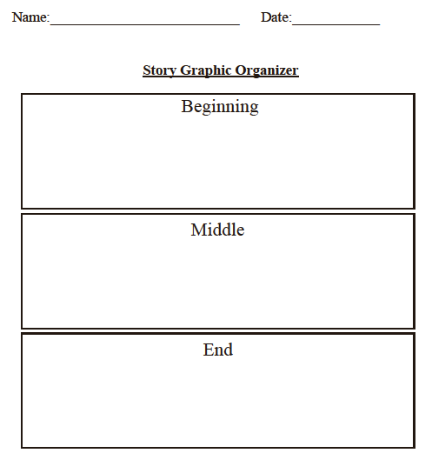
Courtesy of MindWing Concepts, Inc.

Slide 21
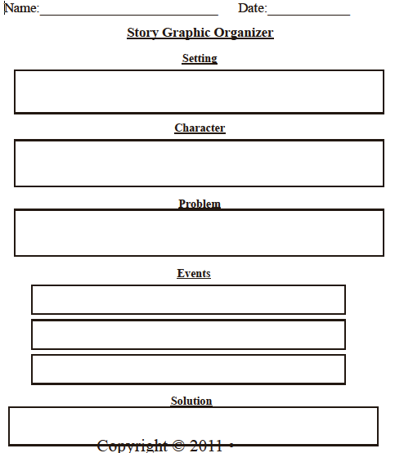
Courtesy of MindWing Concepts, Inc.

Slide 22
2. Use of Story Grammar
Part of a story grammar
characters
setting
initiating event (problem in the story)
internal response (how did the character feel)
internal plan (what plan did the character make to solve the
problem)
attempt (what attempts did the character make to solve the
problem)
consequence (were the attmpts successful or where there
complications)
resolution or reaction (to the consequence)
ending (what was the resolution to the story, how did the
character feel at the end of the story, was there a moral to the
story)

Slide 23
Story Grammar Marker by MindWing Concepts

Slide 24
Assessment Tools to Evaluate Narrative Skills
Use of a Rubric: A scoring tool that explicitly charts the criteria and describes the level of quality for student work. It involves these steps:
1. Determine what performance task to evaluate.
2. Determine a time frame when the performance task is expected to be
achieved.
3. Choose a set of measurable criteria to determine if a performance
task or goal has been achieved.
4. Determine a method of how progress will be measured.
5. Set a schedule to determine when progress will be measured.
Example: Using modeling, visual prompts, and verbal prompts, student will retell a story with a
beginning, middle, and end, where each part contains at least 2-3 details consistent with the
story, with 80% accuracy during a 6-week period. (This can be charted.)
Story Grammar Marker: Use the various components of the story grammar to assess a student’s narrative skills.
Test of Narrative Language (TNL): This assessment tool measures a student’s ability to answer questions about stories read to him/her, retell stories, and create his own stories.

