Slide 1
Interprofessional Education (IPE)
Global and Intercultural Perspectives
Brian B. Shulman, PhD, CCC-SLP, ASHA Fellow, BCS-CL, FASAHP
Dean and Professor of Speech-Language Pathology
School of Health and Medical Sciences
and
Professor of Pediatrics
Seton Hall-Hackensack School of Medicine
Seton Hall University, USA
Beyond Borders: Global trends, local relevance
PASP NATIONAL CONFERENCE
Manila, Philippines
July, 2016
file:///.file/id=6571367.6769982

Slide 2
What is IPE?
According to the World Health Organization, “Interprofessional education occurs when students from two or more professions learn about, from, and with each other to enable effective collaboration and improve health outcomes.”
Notes:
Framework for Action on Interprofessional Education and Collaborative Practice (World Health Organization)
Insights Magazine

Slide 3
IPE Core Values
IPE focuses on the needs of individuals, families and communities to improve the quality of care, health outcomes and wellbeing.
IPE applies equal opportunities within and among the professions and with all whom they learn and work.
IPE respects individuality, difference and diversity within and among the professions and with all whom they learn and work.
IPE sustains the identity and expertise of each profession.
IPE encourages students’ participation in planning, progressing and evaluating their learning.

Slide 4
IPE Core Values (cont’d)
IPE enables the professions to learn with, from, and about each other to optimize exchange of experience and expertise.
IPE synthesizes theory and practice.
IPE grounds teaching and learning in evidence.
IPE enhances practice within each profession.
IPE improves outcomes for individuals, families and communities.

Slide 5
Where does IPE lead us?
This initiative begins in the classroom, teaching students as well as current health care service providers what it means to develop and manage a team-based, patient/person-centered plan by harnessing the expertise of each healthcare professional.
IPE is essential in changing the future of healthcare provided because it promotes Interprofessional Practice (IPP)
Notes:
Insights Magazine

Slide 6

Interprofessional Practice (IPP)
IPP occurs when multiple health workers from different professional backgrounds provide comprehensive services by working with patients, their families, caregivers, and communities to deliver the highest quality of care across settings.

Slide 7
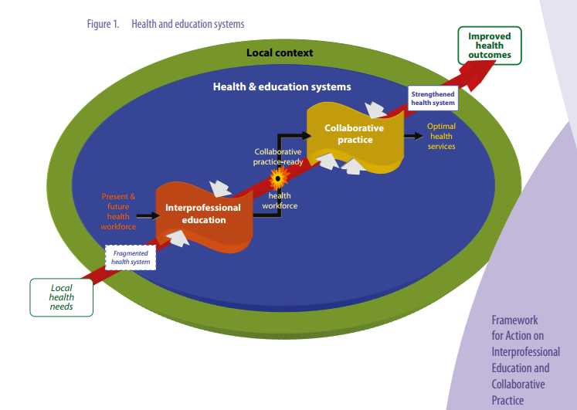


Slide 8
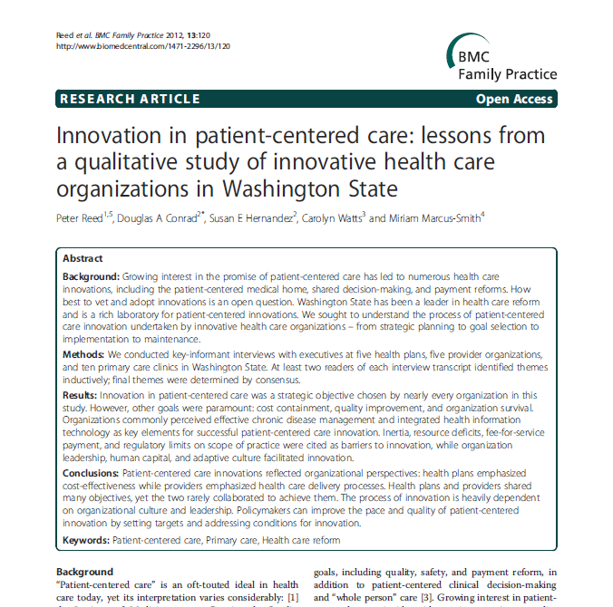
Why IPE and IPP?
Current research expresses how important a Patient-Centered Care (PCC) approach to healthcare is
Healthcare is returning to putting the “whole person care” focus back on patients which, in turn, is urging collaboration between healthcare professionals
With this in mind, innovations and goals are the same for everyone
Notes:
The article pictured discusses specific innovations occurring within patient-centered care like: patient-centered decision-making, payment reform and patient-centered medical home. It discusses how goals of many different medical organizations are the same and how those goals are leading to the administration of better “all-around” care for patients.

Slide 9
IMPLEMENTATION
FRAMEWORK
Foundation: Interprofessional Education at the School of Health and Medical Sciences, Seton Hall University
Planning and School-wide Implementation: Interprofessional Education Task Force
Curricular Integration

Slide 10
OVERVIEW SCHOOL OF HEALTH AND MEDICAL SCIENCES
The School's mission is to prepare health care professionals to assume leadership roles in the health care arena. To achieve this goal, a variety of unique and innovative educational programs are offered utilizing a multi-institutional and integrated approach to graduate education.

Slide 11
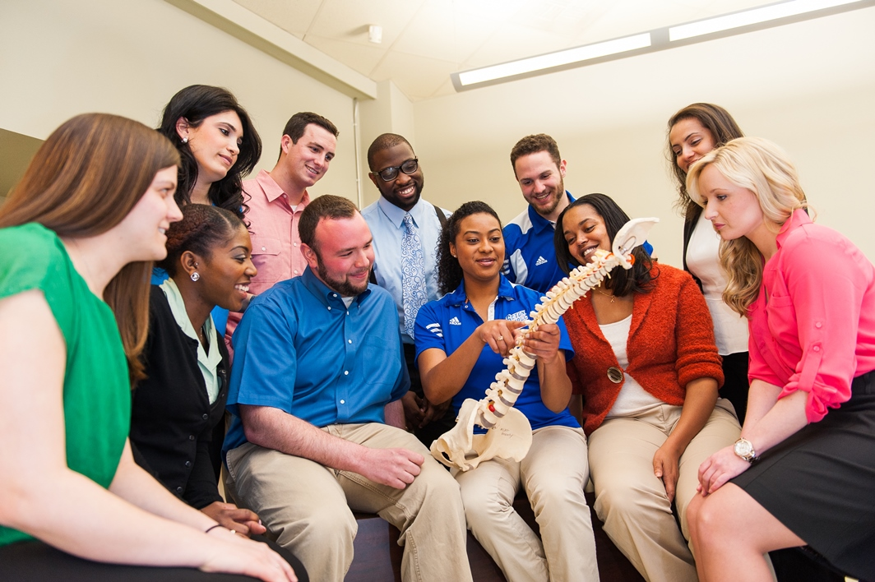
>5 professional programs, Master of Science in Healthcare Administration and a post-professional PhD program in Health Sciences (3 specialization tracks); Global Health Certificate Program
>Approximately 60 full-time faculty in the Health Sciences domain and close to 600 students across 5 professional programs
>More than 600 clinical affiliation agreements with educational and healthcare partners in the State of New Jersey and beyond
>International clinical and research partnerships in many countries including the Philippines, Denmark, Ireland, Brazil, England, Dominican Republic, Belgium, Finland, among others.

Slide 12
FOUNDATION
Create a Task Force
Develop a 5-year Strategic Plan
Develop a proposal: Center for Interprofessional Education in the Health Sciences
Provide resources (funding and personnel) to implement faculty and student centric initiatives

Slide 13

TASK FORCE
Genevieve P. Zipp, PT, EdD, Chair
Terrence Cahill, EdD, FACHE
Vikram N. Dayalu, PhD, CCC - SLP
Carolyn Goeckel, MA, ATC
Michael F. LaFountaine, EdD, ATC
Catherine M. Maher, PT, DPT, GCS
Thomas J. Mernar, PhD, OTR
Howard J. Phillips, PT, PhD, OCS, ATC, FAAOMPT
Denise Rizzolo, PhD, PA-C
Josephine DeVito, PhD, RN ++

Slide 14
IPE can work if we…
Acknowledge & foster grassroots efforts
Foster connections
Build expectations
Encourage wider faculty/practiotioner adoption

Slide 15
PLANNING
Faculty from all departments volunteered to be a part of this Task Force; members chose a chairperson
Developed a 5-year Strategic Plan
Simultaneously, Task Force members interviewed colleagues to identify existing IPE activities
Identified national and international centers of excellence in the domain of IPE
Conducted a detailed review of literature related to IPE
Curriculum mapping

Slide 16
PLANNING
Five Year Strategic Plan
  Mission Statement: To create experiential learning opportunities that foster individual development of quantitative and qualitative skills necessary for effective collaboration among health care providers to ensure the highest quality of patient centered-care.
  Goal 1: Foster a community of faculty, students, practitioners, and staff that value interprofessional evidenced-based educational experiences within the academy as a mechanism to support a strong foundation for the advancement of interprofessional evidenced-based practice.
  Goal 2: Create student experiential learning opportunities that foster individual development of quantitative and qualitative skills necessary for effective collaboration among health care providers to ensure the highest quality of patient centered-care.

Slide 17
School-Wide Implementation Faculty Centric Activities
Baseline survey of faculty on their perception of IPE
Faculty Retreat focused on exploring evidence-based IPE practices
Follow-up survey
2nd Faculty Retreat- Included a workshop titled “Exploring Possibilities in IPE” with experts in health professions education from across the Northeast
Developed an annual faculty award -Award for Excellence in Interprofessional Education
Faculty-to- Faculty round table discussions on Teaching Excellence

Slide 18
School-Wide Implementation Student Centric Activities
Conceptualizing Student Activities: IPE experiences are offered at major transitional points within each health science programs curriculum
  Core Signature IPE Experiences
  IPE Experiences must support the following:
    Patient-centered care
    Evidenced-based practice
    Critical thinking
    Transformative learning experiences using apprenticeships and mentorship experiences and interprofessional teaming opportunities.

Slide 19
School-Wide Implementation Student Centric Activities
Core Signature IPE Experience # 1
  engage pre-professional health science students
  screening of a commercially developed video entitled “Autism in Love” (ReelAbilities™)
  exposed pre-professional students to the various healthcare professionals that potentially might collaborate on a patient’s plan of care
Core Signature IPE Experience # 2
  Foundational awareness on IPE on orientation day
  Brief introductory presentation, followed by the viewing of a commercially produced client video

Slide 20
School-Wide Implementation Student Centric Activities
Core Signature IPE experience # 3
  Interprofessional Perspectives Speaker Series (IPSS) is an annual event for the School’s student body, faculty, SHU community at large, School’s clinical community partners and our neighbors in the community
  Designed to motivate and assist students in seeing themselves as part of a global community addressing today’s health care issues
  The Interprofessional Perspectives Speaker for 2013 was Eric LeGrand, Rutgers University student athlete who suffered a spinal cord injury during a University football game

Slide 21
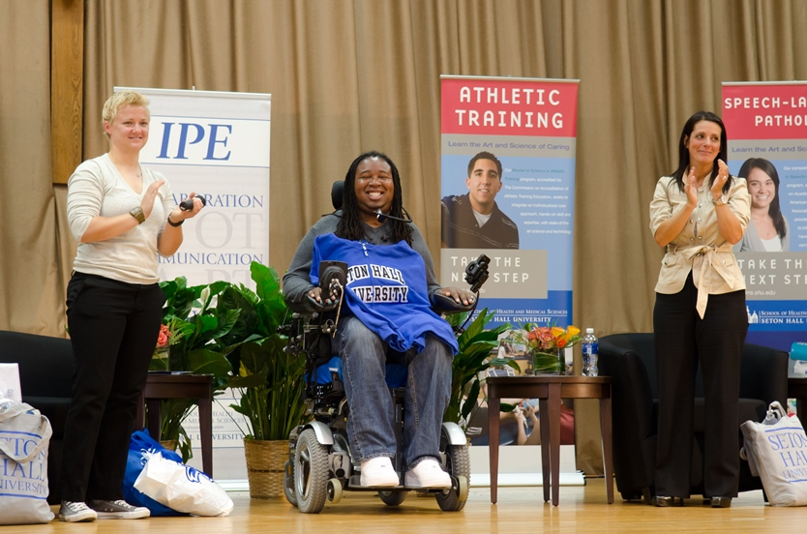
Eric LeGrand

Slide 22
School-Wide Implementation Student Centric Activities
Core Signature IPE Experience # 4
  Town Hall Discussion (THD) for Year 1 didactic level health science students.
  Health care professionals from the community facilitate a panel discussion on “today’s health care environment and potential impacts on patient-centered care”.
Core Signature IPE Experience # 5
  Interprofessional Education Symposium (IES) is held for students prior/during their full time clinical experience.
  The IES experience uses a video case that is developed and unfolded by a master clinician from one of our School’s clinical partners.

Slide 23
School-Wide Implementation Additional Activities
Relay for Life Event
  student groups from the five professional programs have coordinated efforts to participate in Seton Hall University’s Relay for Life
  The Relay is an overnight event from 5pm to 5am where students will walk throughout the evening in order to raise money and awareness for the American Cancer Society
Disaster Preparedness Event
Community Blackboard Site for Students and Faculty
Student Liaisons from each department are included in Task Force meetings and discussions
IPE based CEU events

Slide 24
SHMS-IPE Research
Zipp, G. P., et al. Creating an IPE Infusion Plan: From Foundation to Implementation. Journal of Allied Health, 43(1), e25–e29.
  ABSTRACT: Today’s health care system has embraced the model of collaborative interprofessional efforts among health care professionals to achieve desired patient health outcomes. The Academy can offer the foundational experiences needed to support and develop interprofessional patient-centered plans of care for health professional students. This paper explores one institution’s approach to the creation of an infusion plan which the authors have termed a “structured immersion approach” (SIA) to interprofessional education (IPE). The SIA supports “Core Signature IPE” experiences within existing silo-based curriculums that allow for interprofessional education experiences and the appreciation of the importance of interprofessional practice in today’s health care.

Slide 25
SHMS-IPE Research
Zipp et al., (2013). Student perceptions of visually unfolding case-based (VUCB) IPE experience as a teaching and learning model for the promotion of interprofessional care in health science students. Poster presented at the Annual meeting of the Association for the Behavioral Sciences and Medical Education.
Zipp, et al. (2013). Developing an IPE strategic plan: embracing faculty and student development. Presentation at the ASAHP Annual Conference, Orlando, Florida.

Slide 26
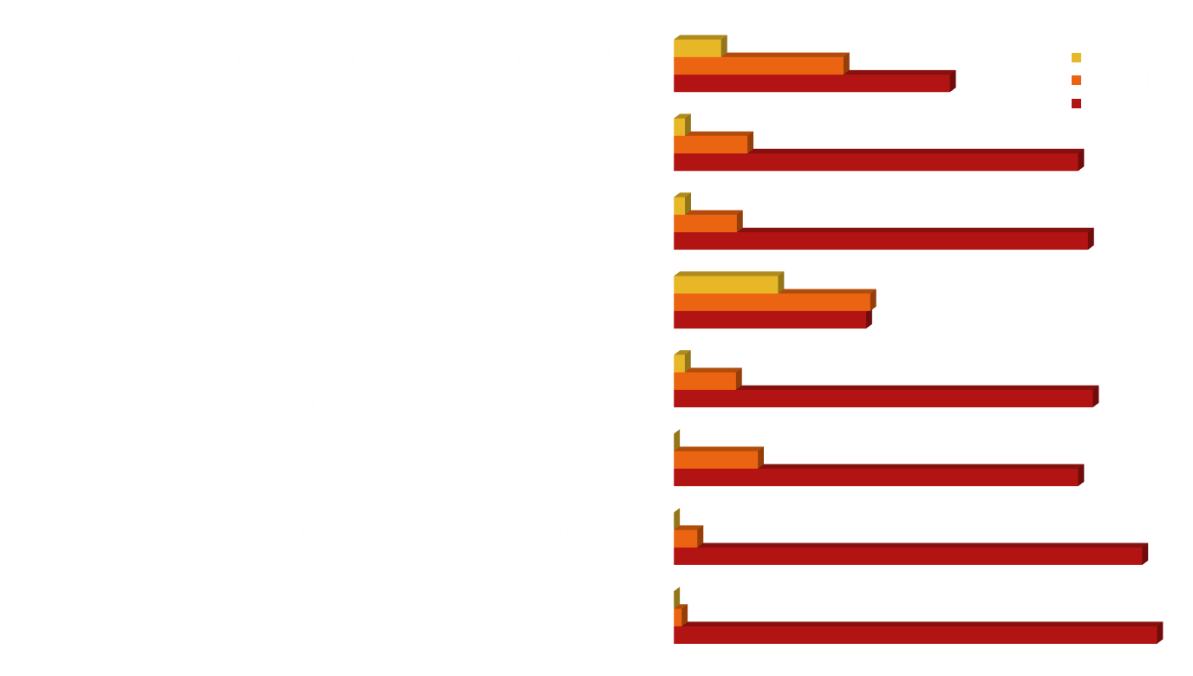
Example of Survey Data from students after attending the Core Signature IPE Experience # 5
IPE Symposium provided opportunities to….

Slide 27
The Future of IPE at SHMS
Explore the development of a Core IPE Curriculum
Explore IPE based service learning programs
Use Web-based tools to expand the IPE Core Signature Events
Assess the impact of IPE across professions

Slide 28
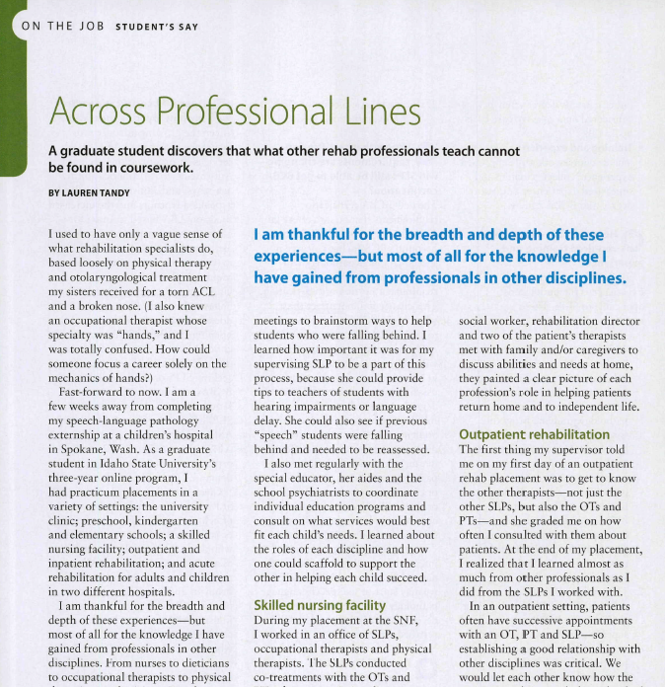
IPE and the Speech-Language Pathology Community
Speech-language pathologists/therapists are in a unique position because not only do they help to improve any communication impairments with their patients, they have the ability to effectively communicate and improve understanding between all healthcare professionals.
Lauren Tandy, a speech language pathology graduate student at Idaho State University, learned through IPE how helpful knowing what other professions did when it came to her own treatment as well as how important it was for her to teach those other professions about what she did.
“I am thankful for the breadth and depth of these experiences—but most of all for the knowledge I have gained from professionals in other disciplines.”
Notes:
In this article, Lauren Tandy wrote about her IPE experience. She discovered that she was learning just as much about helping patients from other professions as she was from her own SLP supervisors. A focus in her program was IPE and she was extremely thankful for that because she felt she came out with a better understanding of what team-based healthcare and IPP she and others can provide.

Slide 29
Integrating IPE into the SLP Curriculum
SLP students participate in Core Signature IPE Experiences within SHMS
SLP students learn about IPE and experience IPP within the SLP curriculum
SLP students engage in IPE Experiential Opportunities

Slide 30
OVERVIEW
SHMS IPE EVENT
DEPARTMENT EVENTS
Core Signature # 1 (UG)
Core Signature # 2 (Fall 1)
Core Signature # 3 (Fall 1)
Core Signature # 4 (Spring 1)
Core Signature # 5 (Spring 2)
Course on Professional Issues (Fall 1)
ETO- Summit (Fall 1)
ETO- PG + JFK (Spring 1)
Research Methods II +TBI (Summer)
ETO- Horizon (Fall 2)
IPE Clinical Experience in Oral Health (Fall)
Additional events

Slide 31
DEPARTMENT EVENTS
Educating students on the role of IPE in facilitating IPP and better patient outcomes
  Lecture on IPP and the respective roles of the different professionals is presented as a part of the Professional Issues course by a member of the Task Force
  Research Methods II Course- Discuss research protocols across different professions
  Clinical Seminar + Traumatic Brain Injury Course- Guest lectures and discussions on IPP between SLP, AT, OT, and Audiologist
  Aural Rehabilitation Course and The Craniofacial Anomalies Course - The IPP aspects related to SLP, Audiologist, neonatologist, plastic surgeon etc. discussed

Slide 32
DEPARTMENT EVENT-IPE CLINICAL EXPERIENCE
Faculty in the SLP and PA department collaboratively developed an Oral Care Initiative to be deployed across age groups and facilities
The Overall goals of this initiative is for students to
  Engage in effective communication skills and collaborative practice with other health professionals
  Explore the unique contributions of other health professions and gaining an understanding of their scope of practice
  Develop interpersonal skills by engaging in an interprofessional community project
  Recognize ones’ roles and responsibilities as an interdisciplinary health care team member
  Cultivate knowledge base in the professional practice area
  Engage in teamwork across different healthcare disciplines

Slide 33
DEPARTMENT EVENT-IPE CLINICAL EXPERIENCE
SLP students engage in IPE Experiential Opportunities
  IPE Experience # 1: Passaic School District Oral Hygiene Project
  IPE Experience # 2: Paterson Dental Health Clinic-Promoting Oral Health
  IPE Experience # 3: Innovative Professional Program (Jespy House)

Slide 34
IPE EXPERIENCE # 1
Passaic School District Oral Hygiene Project
  Students in the speech-language pathology department partner with physician assistant students in promoting good oral hygiene and healthy teeth for speech and feeding development for elementary age students (pre-K to six grade)
  This project is run at a private school. The PA students focus on dental hygiene while the SLP students discussed the importance of good dental status for both speech production and feeding and created a worksheet to highlight it

Slide 35
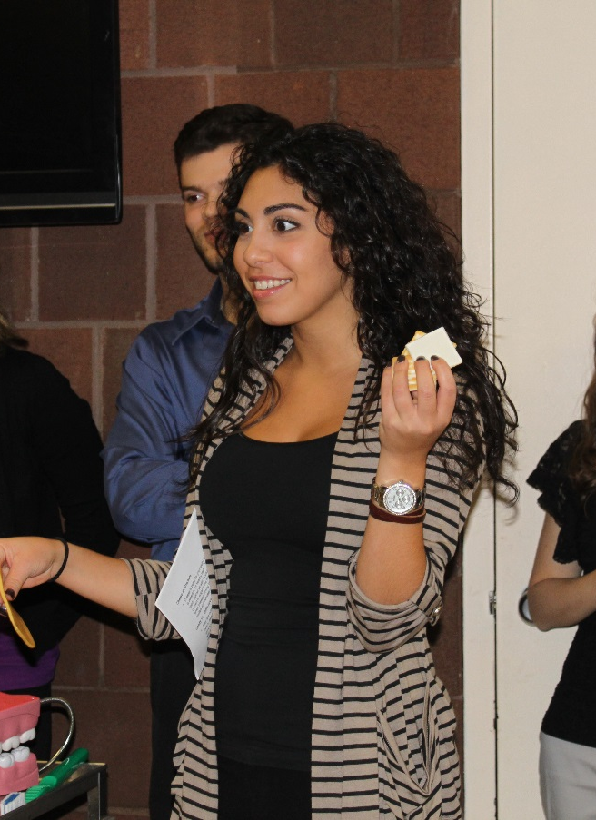
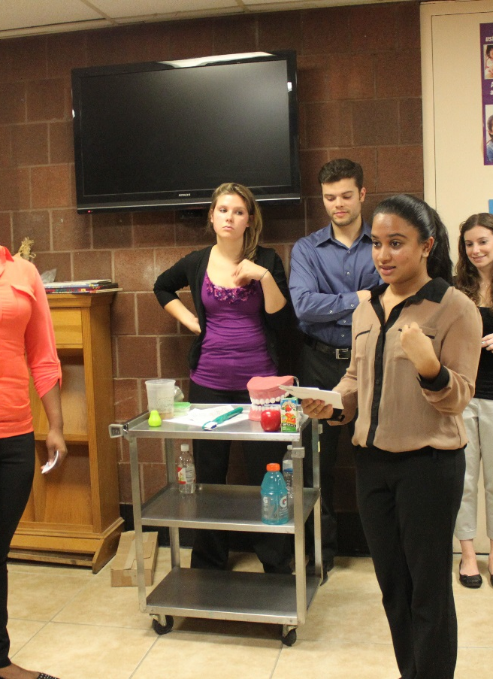
Which food is better for your teeth?
Teaching children the importance of Nutrition on Oral Health
Can you say your name without touching your front teeth?
Teaching children what would happen if they lost their teeth

Slide 36
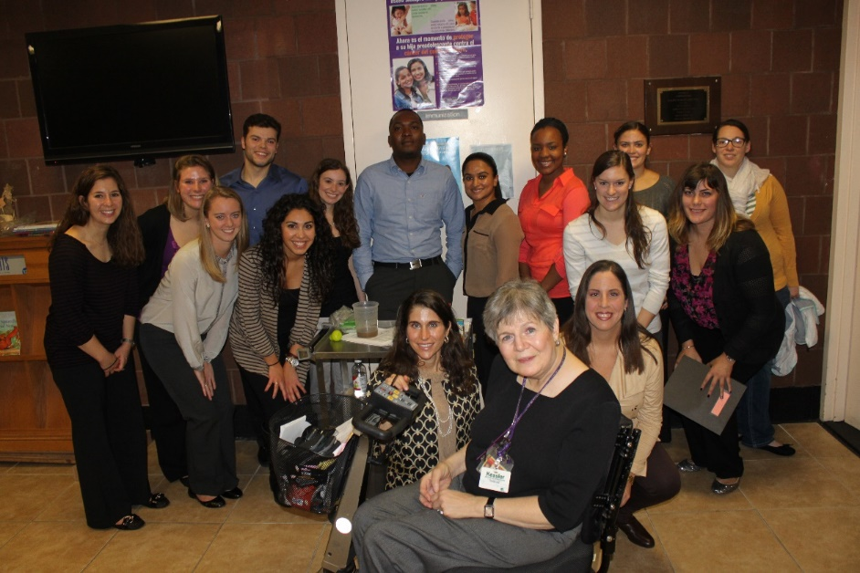
PA and SLP Team Working Together

Slide 37
ADDITIONAL IPE ACTIVITIES
International Innovation Project
  The Occupational and Physical Therapy departments participated in a collaborative community service project with PT and OT students from Helsinki. Together they developed socially and vocationally-based innovations for individuals with special needs in this group home. Assisted in fostering their independence with their activities of daily living.
Camp Chatterbox
  Scholarship opportunities for SLP students to intern at a camp for children with multiple disabilities using AAC. Students gain specialized training in augmentative and alternative communication methods working hand in hand with teachers, social workers, AAC specialists, parents, OT’s, PT’s. This is not operated by Seton Hall but we encourage students to consider attending
Overseas clinical training in the Philippines!
  Each year, Seton Hall SHMS students avail the opportunity to gain clinical exposure and service learning opportunities under the auspices of the University of Philippines-Manila Campus, the University of Santo Tomas, DLSHCI—Dasmarinas, and Silliman University.

Slide 38
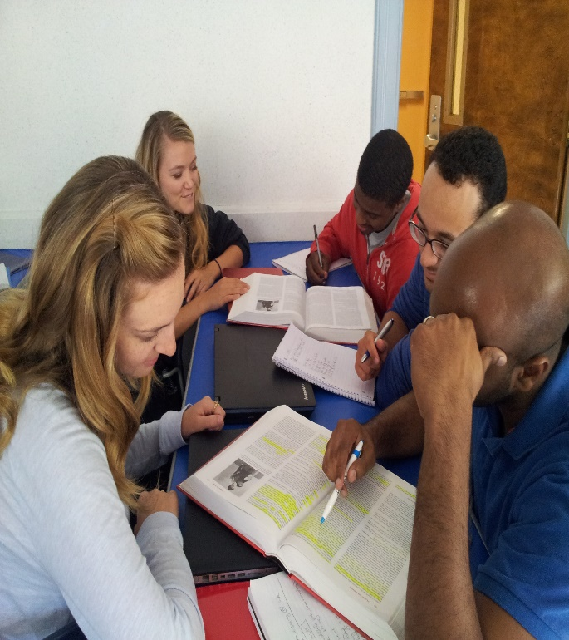
Take HOME MESSAGE…….
Prepare, support and empower faculty/practitioners
Prepare, engage, and empower students
Stay true to the principles of IPE for the promotion of IPP and PCC

Slide 39
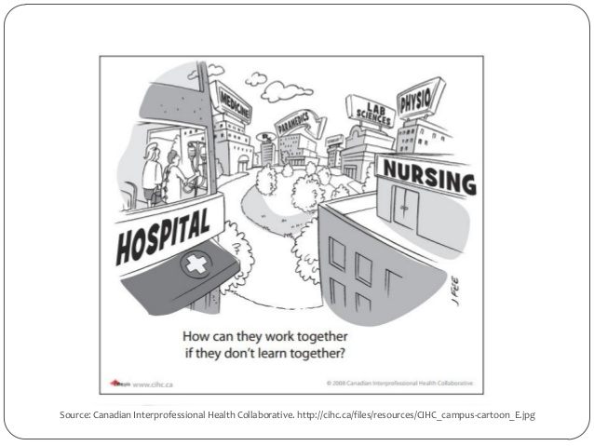

Slide 40
SELECTED REFERENCES
Areskog, N. H. (1988) The need for multi-professional health education in undergraduate studies. Medical Education, 22, 251-252.
Parsell, G., &Bligh, J. (1999) The development of a questionnaire to assess the readiness of health care students for interprofessional learning (RIPLS). Medical Education, 33, 95-100.
Thistlewaite, J., & Nisbet, G. (2007). Interprofessional education: What’s the point and where we’re at. The Clinical Teacher, 4, 67-72.
World Health Organization (2010). World Health Statistics 2010. WHO Press, Geneva, Switzerland.
Additional materials
Dunston, R., Lee, A., Slade, D., Lee, A., Matthews, L., Nisbet, G., Pockett, R., Thistlethwaite, J., & White, J. (2007). Developing interprofessional learning and practice capabilities within the higher education sector; Australian Learning and Teaching Council/Priority Projects Program.
Interprofessional Education Collaborative Expert Panel. (2011). Core competencies for interprofessional collaborative practice: Report of an expert panel. Washington, D.C.: Interprofessional Education Collaborative.

Slide 41


THANK YOU

